Slide 1
FILE HANDLING

Slide 2
File is collection of data stored externally on an external media (not in RAM).
Every file has two attributes:
    File Name is the name of the file
    File Path is the location of the file
File name consists of two parts normally separated by a '.' (dot) e.g. sample1.txt
Name is the name of the file (sample1 in sample1.txt)
Extension is the type of the file (txt in sample1.txt) which means it is a text file containing printable characters.
The extension also specifies the default program used to open the file. For example .txt file is opened with Notepad, .c files are opened with c compiler, .exe files are executed by the OS etc.)
File path is the location (a series of directories) where the file is located: for example:C:\Users\rsari\Desktop\Code Tantra\Python\ (This is the absolute path).
The path can be relative to the current directory. The current directory is the default directory.

Slide 3
In Python, file operation takes place in the following order:
  Open the file
  Read / Write (perform operation on the file)
  Close the file
Other operations include:
  Rename
  Delete
Create and Open a file in Python:
To do any operation with a file, such as read/write to it or even just to print its contents, we need to open the file.
To open the file, we use the built-in open() function
The open() function returns a file object representing the file. The file object is also called as file handle because it is used to read or modify the file accordingly.
Syntax:
file_object = open(filename, mode)

Slide 4
mode - It is the second argument in the open() function syntax. It tells Python Interpreter the type of operation we want to do on a file. It is an optional argument. By default, it is set to read-only 'r'. In this mode, we get data in text form after reading from the file.
There are several other modes which will be discussed later.
Example:
f = open('sample1.txt', 'w')
It will try to open a new file with name sample1.txt in write mode in the current directory.

Slide 5
FILES
To open a ﬁle, you specify its name and indicate whether you want to read or write
>>> f = open("test.txt","w")
>>> print f
<open file ’test.txt’, mode ’w’ at fe820>
    First argument: Name of the ﬁle
    Second argument: mode (“r” for Read/”w” for Write)
If there is no ﬁle named test.txt, it will be created. If there already is one, it will be replaced by the ﬁle we are writing.
If we try to open a ﬁle that doesn’t exist, we get an error:
>>> f = open("test.txt","r")
IOError: [Errno 2] No such file or directory: ’test.cat’

Slide 6
On a computer, every file is a long string of zeros and ones. At a generic level of description, there are two kinds of computer files: Binary or Text. We usually identify a file as binary or text based on its extension.
Binary file:
A binary file is a computer file that is not a text file. It contains a sequence or a collection of bytes which is computer-readable but not human-readable.
A binary file always needs a matching software to read or write it. Most of the files that we see in our computer system are called binary files.
Common extensions that are binary file formats:
Image files: .png, .jpg, .gif, .bmp etc.
Video files: .mp4, .3gp, .mkv, .avi etc.
Audio files: .mp3, .wav, .mka, .aac etc.

Slide 7
Text file:
A text file is a computer file that stores data in the form of alphabets, digits and other special symbols by storing their ASCII values and is in a human readable format. A text file can be viewed or edited in any text editor.
Common extensions that are text file formats:
Web standards: html, XML, CSS, JSON etc.
Source code: c, app, js, py, java etc.
Documents: txt, tex, RTF etc.
The only difference is that when a text file is opened the data is decoded back using the same encoding scheme they were encoded in. However, in the case of binary files no such thing happens.
As discussed earlier, the mode in the syntax of open() function will tell Python Interpreter the type of operation to be performed on a file.

Slide 8
The following modes are for opening, reading or writing text files only:
'r' – Read mode is the default mode used only to read data from the file.
‘w'– Write mode is used when you want to write data into the file or modify it. Remember write mode overwrites the data present in the file. It will create a new file if the same does not exist.
‘a' – Append mode is used to append data to the file. Remember data will be appended at the end of the file pointer. If the file doesn’t exist, then it will be created.
'x' -- Opens a file for exclusive creation. If the file already exists, the operation fails.
‘r+' – Read or Write Mode: This mode is used when we want to write or read the data from the same file.
‘a+' – Append or Read Mode: This mode is used when we want to read data from the file or append the data into the same file.
While using binary files, we use the same modes with the letter ‘b' at the end, so that Python Interpreter can understand that we are interacting with binary files.
‘wb’ – Open a file for write-only mode in the binary format.
‘rb’ – Open a file for the read-only mode in the binary format.
‘ab’ – Open a file for appending-only mode in the binary format.
‘rb+’ – Open a file for read and write only mode in the binary format.
‘ab+’ – Open a file for appending and read-only mode in the binary format.
Note: 't' is used for text file and 'b' for binary files. If neither is specified, 't' is assumed by default.

Slide 9
WRITING DATA
To put data in the ﬁle we invoke the write method on the ﬁle object with w
>>> f = open("test.txt","w")
>>> f.write("Now is the time")
>>> f.write("to close the file")
Closing the ﬁle tells the system that we are done writing and makes the ﬁle available for reading
>>> f.close()

Slide 10
READING DATA
To read the data from the ﬁle we invoke the read method on the ﬁle object with r
>>> f = open("test.txt",“r")
>>> text = f.read()
>>> print text
Now is the timeto close the file
Read can also take an argument that indicates how many characters to read
>>> f = open("test.txt","r")
>>> print f.read(5)
Now i

Slide 11
READING CONTINUED
If not enough characters are left in the ﬁle, read returns the remaining characters. When we get to the end of the ﬁle, read returns the empty string:
>>> print f.read(1000006)
s the timeto close the file
>>> print f.read()
>>>

Slide 12
APPENDING DATA IN FILE
f = open(“text.txt”,”a”)
f.write(“ this text is for appending “)
f.close

Slide 13
Select all the correct statements given below.
The file name cannot contain spaces
The maximum length of the extension is 3 characters
All extensions are predefined
File extension tells the type of file

Slide 14
Select all the correct statements given below.
The file name cannot contain spaces
The maximum length of the extension is 3 characters
All extensions are predefined
File extension tells the type of file

Slide 15
Select all the correct statements given below.
File path indicates the directory in which the file is located
In the string "c:\users\ravi\desktop\documents\profile.doc", doc is the extension
We can specify the file path relative to the current directory
When the file is in the current directory, the file path need not be specified

Slide 16
Select all the correct statements given below.
File path indicates the directory in which the file is located
In the string "c:\users\ravi\desktop\documents\profile.doc", doc is the extension
We can specify the file path relative to the current directory
When the file is in the current directory, the file path need not be specified
All are correct

Slide 17
File has the following two attributes:
File name and file path
File name and location
File name and extension
File extension and file path

Slide 18
File has the following two attributes:
File name and file path
File name and location
File name and extension
File extension and file path

Slide 19
Writing and reading:
f = open("demofile3.txt", "w")
f.write(“Previous content deleted writing new!")
f.close()
#open and read the file after the appending:
f = open("demofile3.txt", "r")
print(f.read())

Slide 20
Appending and reading
f = open("demofile2.txt", "a")
f.write("Now the file has more content!")
f.close()
#open and read the file after the appending:
f = open("demofile2.txt", "r")
print(f.read())

Slide 21
# Program to show various ways to read and write data in a file.
file1 = open("myfile.txt","w")
L = ["This is Delhi \n","This is Paris \n","This is London \n"]
# \n is placed to indicate EOL (End of Line)
file1.write("Hello \n")
file1.writelines(L)
file1.close() #to change file access modes
file1 = open("myfile.txt","r+")
print("Output of Read function is ")
print(file1.read(5))
print()
# seek(n) takes the file handle to the nth byte from the beginning.
file1.seek(0)
print( "Output of Readline function is ")
print(file1.readline())
print()
file1.seek(0)
# To show difference between read and readline
print("Output of Read(9) function is ")
print(file1.read(9))
print()
file1.seek(0)
print("Output of Readline(9) function is ")
print(file1.readline(9))
file1.seek(0)
# readlines function
print("Output of Readlines function is ")
print(file1.readlines())
print()
file1.close()

Slide 22
# Python program to illustrate Append vs write mode
file1 = open("myfile1.txt","w")
L = ["This is Delhi \n","This is Paris \n","This is London \n"]
file1.writelines(L)
file1.close()
# Append-adds at last
file1 = open("myfile1.txt","a") #append mode
file1.write("Today \n")
file1.close()
file1 = open("myfile1.txt","r")
print("Output of Readlines after appending")
print(file1.readlines())
print()
file1.close()
# Write-Overwrites
file1 = open("myfile1.txt","w") #write mode
file1.write("Tomorrow \n")
file1.close()
file1 = open("myfile1.txt","r")
print("Output of Readlines after writing")
print(file1.readlines())
print()
file1.close()

Slide 23

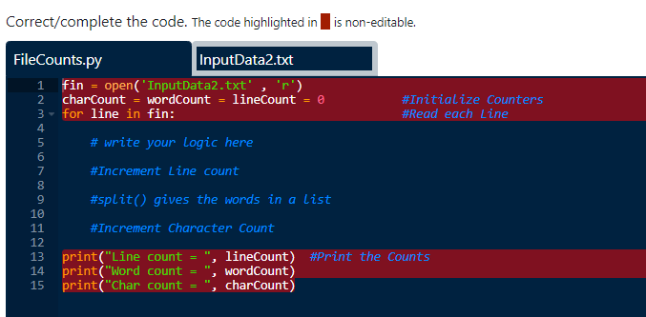
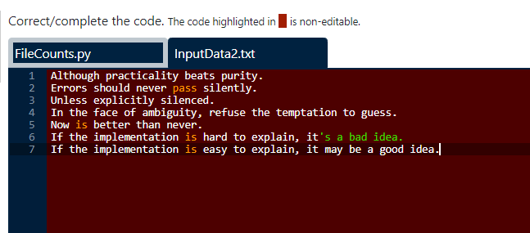

Slide 24
Solution:
#Write a program to print number of lines , words and characters in a file.
#Open the File for input
fin = open('InputData2.txt' , 'r')
charCount = wordCount = lineCount = 0 #Initialize Counters
for line in fin: #Read each Line
lineCount += 1 #Increment Line count
wordCount += len(line.split()) #split() gives the words in a list
charCount += len(line) #Increment Character Count
print("Line count = ", lineCount) #Print the Counts
print("Word count = ", wordCount)
print("Char count = ", charCount)

Slide 25
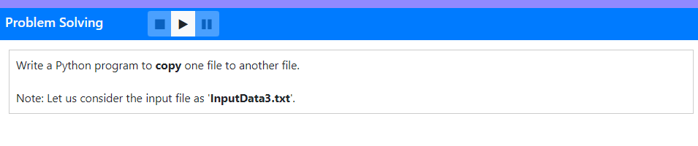
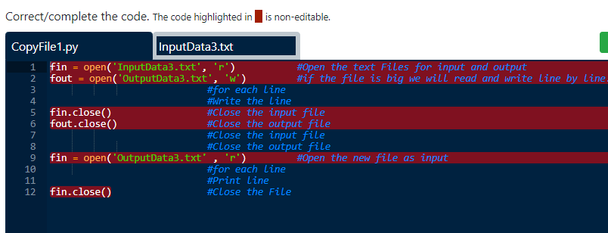
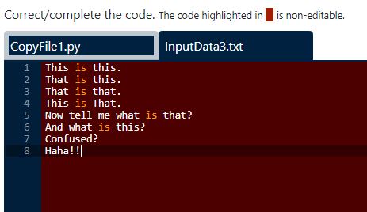

Slide 26
Solution:
fin = open('InputData3.txt', 'r') #Open the text Files for input and output
fout = open('OutputData3.txt', 'w’) #if the file is big we will read and write line by line.
for line in fin: #for each line
fout.write(line) #Write the line
fin.close() #Close the input file
fout.close() #Close the output file
fin = open('OutputData3.txt' , 'r’) #Open the new file as input
for line in fin: #for each line
print(line,end='') #Print line
fin.close() #Close the File

Slide 27
Different File Operations:
The operations that can be performed on an open file are:
read(size) - reads size bytes, if omitted reads the entire file
tell() - tells the position of the file cursor
seek(value) - positions the cursor at the position specified by value
readline() - will read the next line (applicable only for text files) - returns Null if EOF is reached
close() - closes the file
write(str) - will write the string str in the file at the end

Slide 28
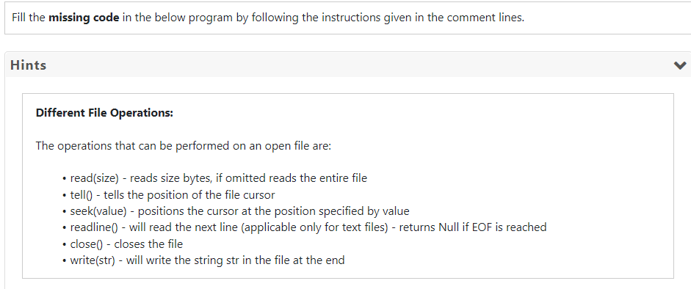
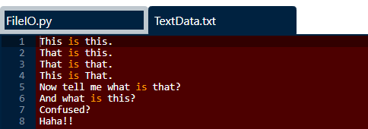
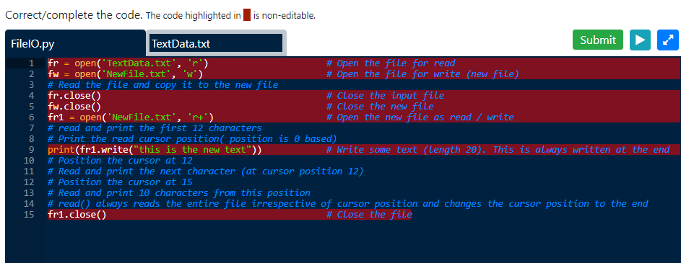

Slide 29
fr = open('TextData.txt' , 'r') # Open the file for read
fw = open('NewFile.txt', 'w') # Open the file for write (new file)
fw.write(fr.read()) # Read the file and copy it to the new file
fr.close() # Close the input file
fw.close() # Close the new file
fr1 = open('NewFile.txt', 'r+') # Open the new file as read / write
print(fr1.read(12)) # read and print the first 12 characters
print(fr1.tell()) # Print the read cursor position( position is 0 based)
print(fr1.write("this is the new text")) # Write some text (length 20). This is always written at the end
print(fr1.seek(12)) # Position the cursor at 12
print(fr1.read(1)) # Read and print the next character (at cursor position 12)
print(fr1.seek(15)) # Position the cursor at 15
print(fr1.read(10)) # Read and print 10 characters from this position
print(fr1.read()) # read() always reads the entire file irrespective of cursor position and changes the cursor position to the end
fr1.close() # Close the file

Slide 30
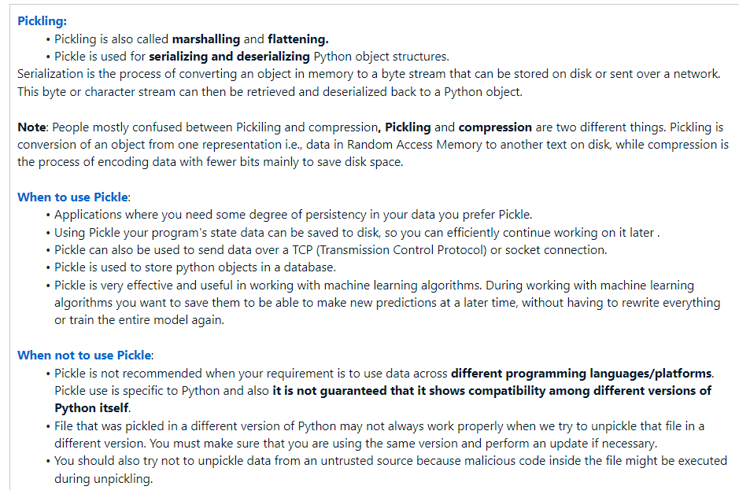

Slide 31
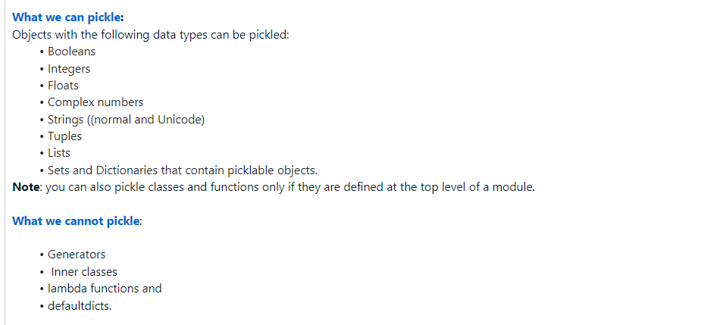

Slide 32
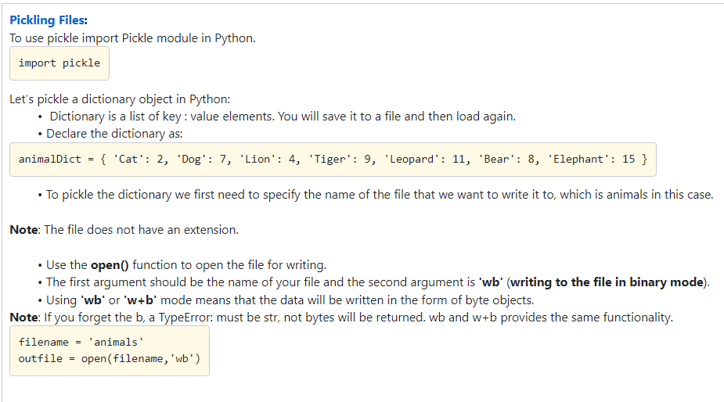

Slide 33
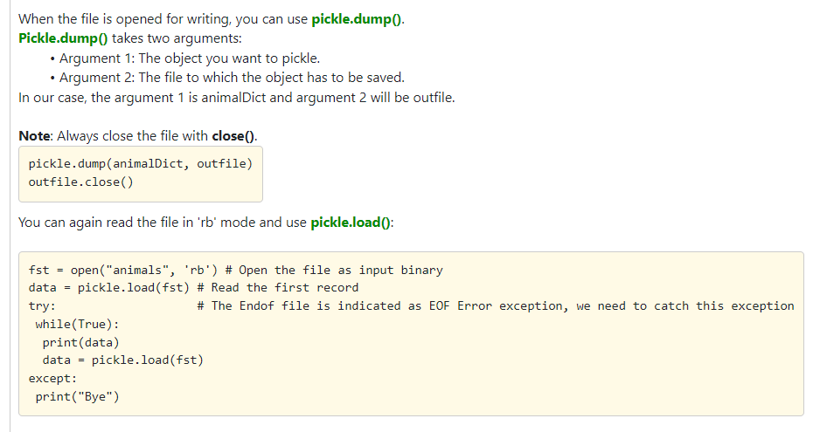

Slide 34
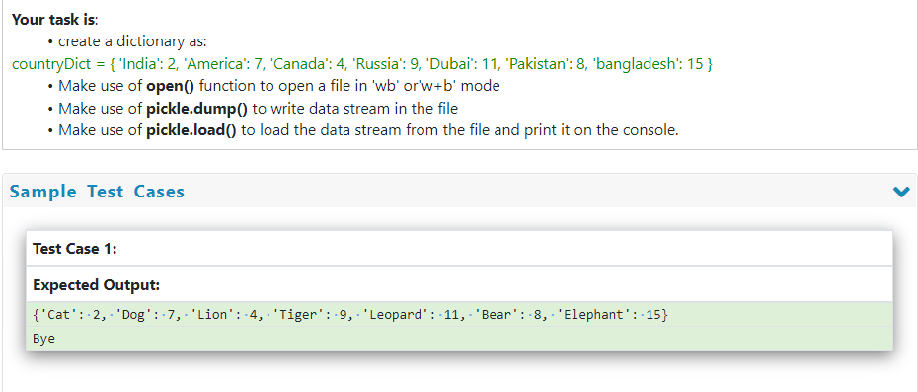

Slide 35
Solution:
import pickle
animalDict = { 'Cat': 2, 'Dog': 7, 'Lion': 4, 'Tiger': 9, 'Leopard': 11, 'Bear': 8, 'Elephant': 15 }
outfile = open('animals','wb')
pickle.dump(animalDict, outfile)
outfile.close()
fst = open("animals", 'rb') # Open the file as input binary
data = pickle.load(fst) # Read the first record
try: # The Endof file is indicated as EOFError exception, we need to catch this exception
while(True):
print(data)
data = pickle.load(fst)
except:
print("Bye")

Slide 36
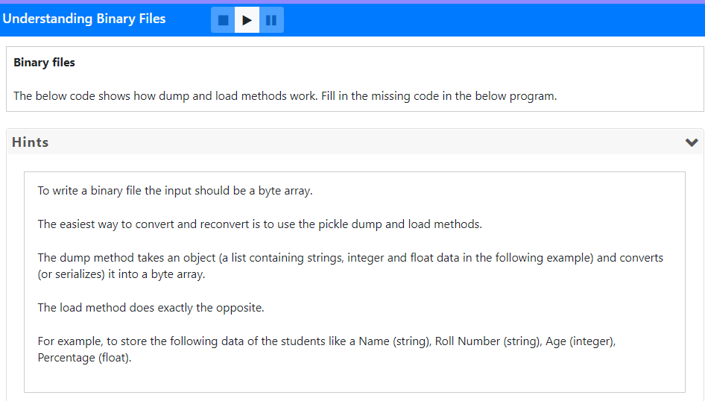

Slide 37
Solution:
import pickle # imports the pickle library
Students = [['John', '501', 20, 92.5],['Kohli', '502', 21, 95.5], ['Ganga','503', 20, 90.5],['Gayathri','504', 20, 82.5],['Krishna','505', 20, 96.5]]
fst = open("students.dat",'wb’) # Open the output file Notice the the b after w to indicate this is a binary file
for student in Students:
pickle.dump(student, fst) # Write each student
fst.close() # Close the output filr
fst = open("students.dat", 'rb') # Open the file as input binary
data = pickle.load(fst) # Read the first record
try: # The Endof file is indicated as EOFError exception, we need to catch this exception
while(True):
print(data)
data = pickle.load(fst)
except:
print("Bye")

Slide 38
MORE ON PICKLING
Things are written as strings in files. To get the original data structures (like lists, dictionaries) back, use the concept of Pickling. To use it, import pickle and then open the ﬁle in the usual way:
>>> import pickle
>>> f = open("test.pck","wb")
To store a data structure, use the dump method and then close the ﬁle in the usual way:
>>> pickle.dump(12.3, f)
>>> pickle.dump([1,2,3], f)
>>> f.close()

Slide 39
PICKLING - CONTINUED
Then we can open the ﬁle for reading and load the data structures we dumped:
>>> f = open("test.pck","rb")
>>> x = pickle.load(f)
>>> x
12.3
>>> type(x)
<type ’float’>
>>> y = pickle.load(f)
>>> y
[1, 2, 3]
>>> type(y)
<type ’list’>

Slide 40
DIRECTORIES
If you want to open a ﬁle somewhere else, you have to specify the path to the ﬁle, which is the name of the directory (or folder) where the ﬁle is located:
>>> f = open(“D:/foldername/newfile.txt”,”w”)
>>> f.write(This is the file in new Directory)
This example opens a ﬁle named words that resides in a directory named dict, which resides in share, which resides in usr, which resides in the top-level directory of the system, called /.
You cannot use / as part of a ﬁlename; it is reserved as a delimiter between directory and ﬁlenames.

